Slide 1

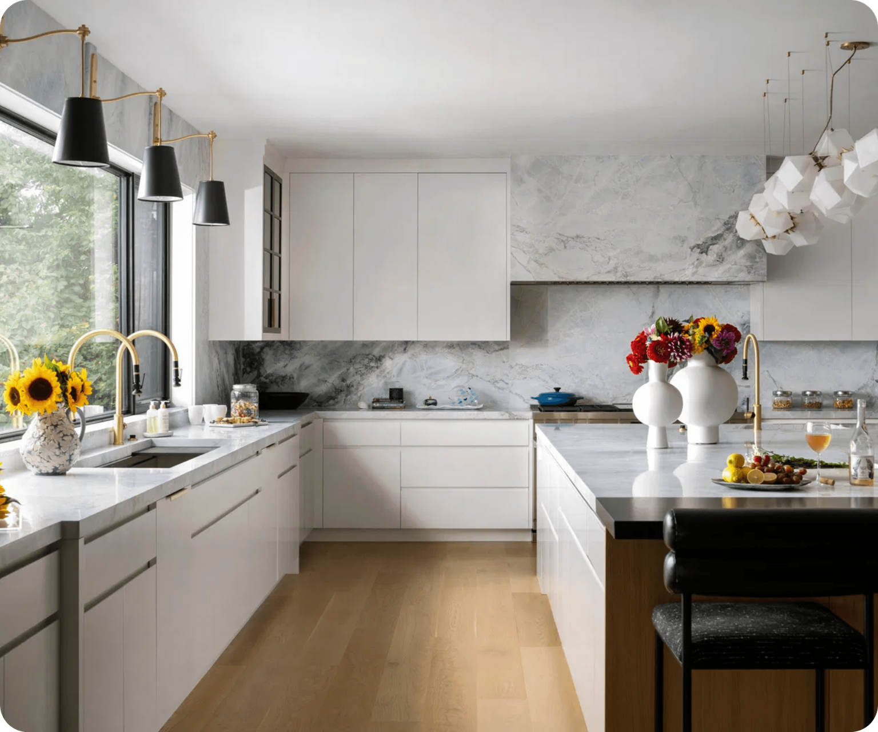
GLORY COOKWARE
GLORY COOKWARE MARKETING STRATEGY
Digital Marketing Strategy

Slide 2

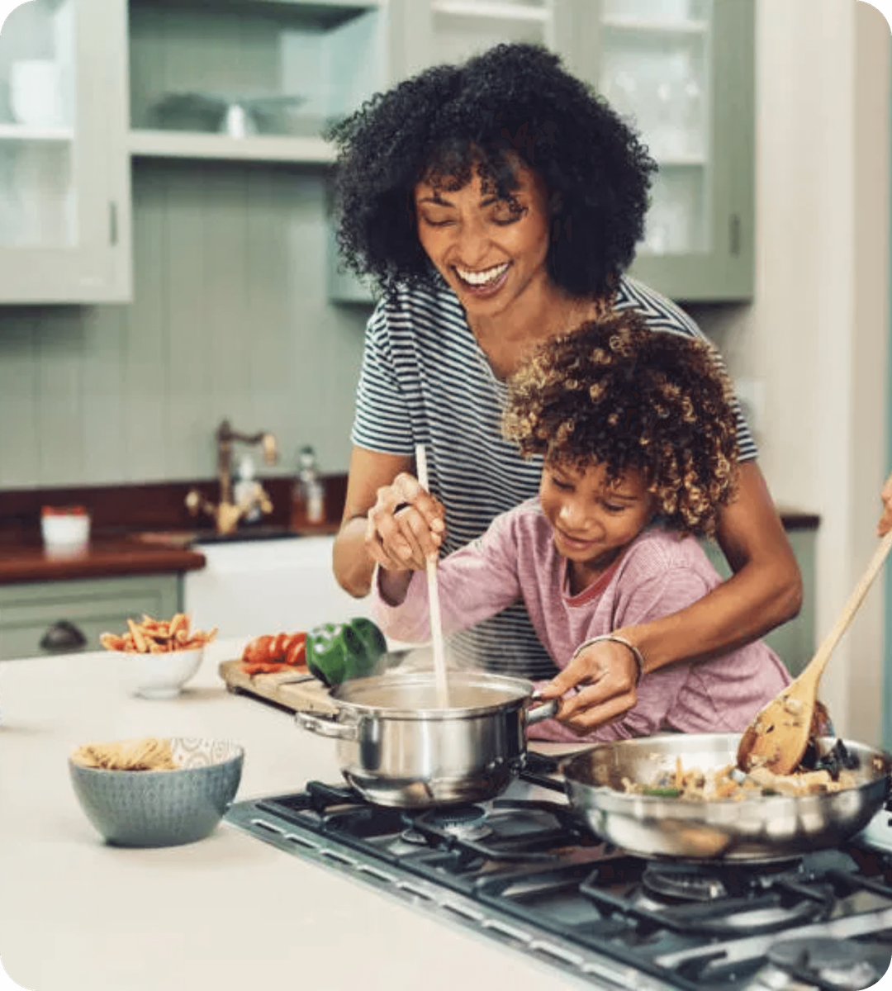

INTRODUCTION
Glory Cookware, established in 2019, specializes in premium granite cookware designed for durability and health. We provide practical, durable, and high-quality products to meet everyday cooking needs.
PRODUCT RANGE
CORE VALUE
High-quality pots, frying pans, grills, and essential kitchen tools.
Practical, long-lasting, and high-performance products for daily cooking.
ESTABLISHED
MARKET FOCUS
Founded in 2019 to bridge the gap between luxury and utility.
Catering to modern households seeking healthier alternatives.

Slide 3
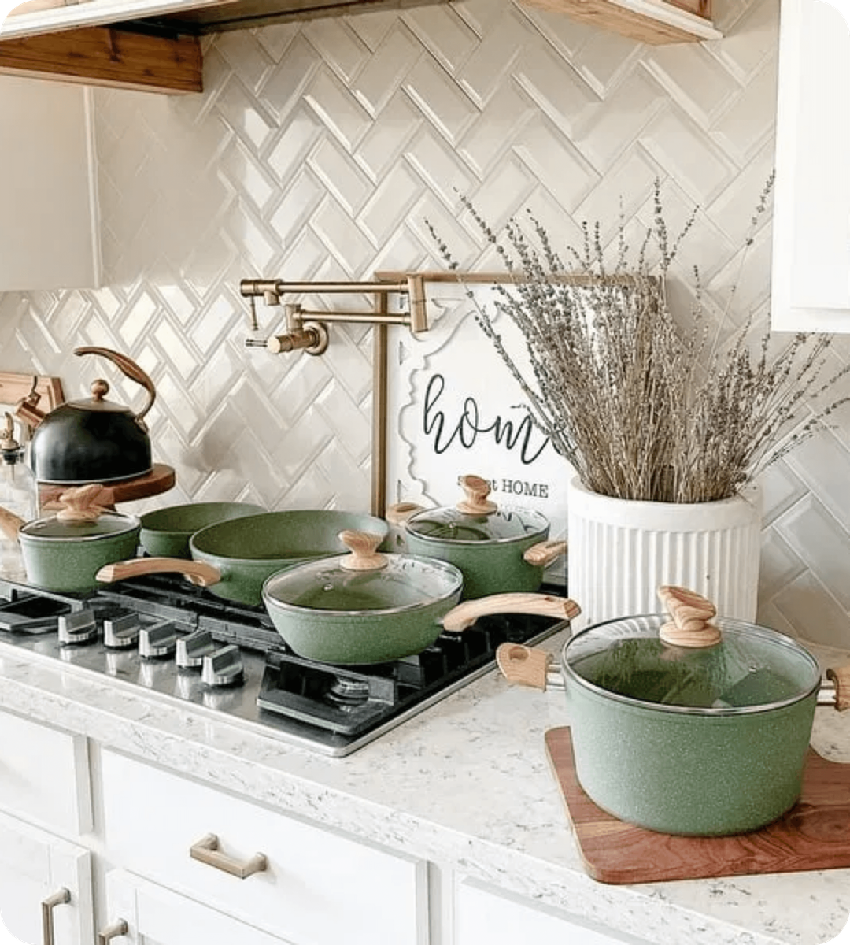


VISION
To be the leading company in the Arab world in providing high-quality cookware using healthy granite technology, giving every kitchen a faster, healthier, and more distinctive cooking experience.
MISSION
At Glory, we work to improve the cooking experience by providing high-quality granite cookware that distributes heat efficiently, is non-stick, easy to clean, and comes in modern colors that suit different tastes.

Slide 4



MARKET RESEARCH: PESTEL ANALYSIS
POLITICAL
ECONOMICAL
SOCIAL
Rising petroleum prices impacting shipping costs.
Inflation increasing raw material and wage costs.
High awareness of healthy, non-toxic cookware.
14% Value Added Tax (VAT) on sales.
Currency depreciation affecting import prices.
Trend of buying large sets for home preparation (brides).
Regional trade route disruptions affecting customs.
Reduced consumer purchasing power for non-essentials.
Interest in modern, attractive kitchen furnishing.
TECHNOLOGICAL
ENVIRONMENTAL
LEGAL
E-commerce growth and social media reviews.
Energy-efficient furnaces and waste reduction.
Consumer Protection Law No. 181 of 2018.
Adoption of digital payments (Visa/E-wallets).
Eco-friendly recyclable packaging focus.
Egyptian Organization for Standardization quality codes.
Advanced manufacturing for heat distribution.
Management of industrial air and liquid emissions.
Intellectual property and trademark protection.

Slide 5




MARKETING RESEARCH: COMPETITORS ANALYSIS
We analyzed four competitors and created a comparison table covering pricing, locations, and digital presence. We evaluated their Facebook, Instagram, TikTok, and websites to identify their strengths and weaknesses. Based on these insights, we developed our marketing strategy.
Key Insights
Pricing: Our prices offer good value for money, making us competitive in the market.
Facebook:
Strong optimization with all channels well integrated.
Weakness: Limited content, with most posts focused only on selling.
Instagram:
Well-optimized profile.
Weaknesses: Highlights need better organization, and the content is mainly sales-oriented.
TikTok:
Minimal presence across competitors.
This creates an opportunity for us to build a strong TikTok strategy and gain a competitive advantage.
Website:
Strengths:
Multiple payment methods.
Saved delivery location for a faster checkout experience.
Weaknesses:
No offline store locations displayed.
No product reviews.
No related products section.
Mixed Arabic and English language, creating an inconsistent user experience.
Conclusion: These insights helped us identify opportunities for improvement and build a stronger digital marketing strategy for Glory Cookware.

Slide 6




SWOT ANALYSIS
STRENGTHS
WEAKNESSES
Excellent customer service.
•
Inconsistent social media response times.
•
Easy website navigation and high-quality visual content.
•
Lack of offline branch addresses and product reviews on website.
•
Distinctive product colors.
factory direct dealing .
•
Content is primarily sales-focused without customer listening.
•
•
OPPORTUNITIES
THREATS
Targeting the bridal market with specialized bundles.
•
Fluctuation in raw material prices and production costs.
•
Partnerships with restaurants and TV cooking programs.
•
Low-priced alternative products flooding the market.
•
Seasonal campaigns for Ramadan and Mother's Day.
•
Competitors' aggressive focus on content marketing.
•

Slide 7
TOWS MATRIX: STRATEGIC ACTION PLANS
SO
MAXI-MAXI STRATEGY
ST
MAXI-MINI STRATEGY
Leverage Instagram's visual appeal to showcase unique colors.
•
Educate consumers on genuine vs. synthetic granite health benefits.
•
Target the bridal segment with premium bundles and aesthetic designs.
•
Highlight product longevity to counter low-cost alternatives.
•
Organize mall activities to capitalize on wide brand reach.
•
Focus on unique color differentiation to stand out from competitors.
•
WO
MINI-MAXI STRATEGY
WT
MINI-MINI STRATEGY
Partner with influencers for professional cooking video content.
•
Implement a robust customer review system to build social proof.
•
Launch "Visit Our Branch" campaigns during peak seasons like Ramadan.
•
Unify brand language and response protocols across all platforms.
•
Clearly announce website offers through coordinated social posts.
•
Engage young creators with targeted gifting and lifestyle content.
•

Slide 8

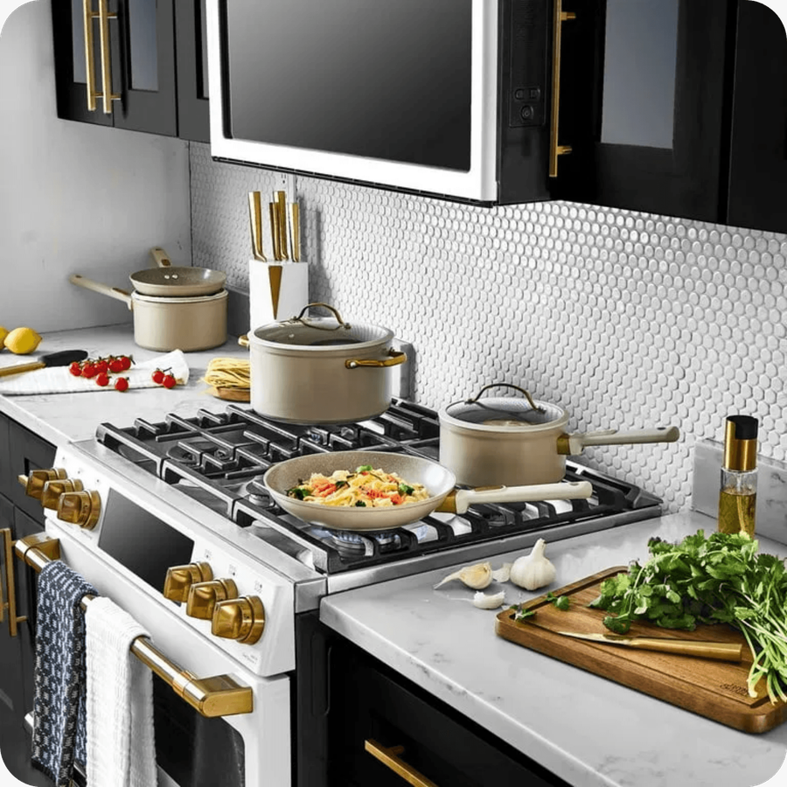
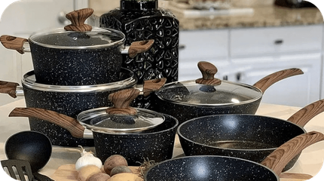
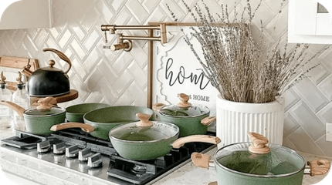
MARKETING MIX (7PS)
PRODUCT
PRICE
Premium granite trays, pots, and pans with distinctive colors and superior heat distribution.
Competitive average pricing offering high value-for-money compared to premium rivals.
PLACE
PROMOTION
Available in Hypermarkets (Carrefour, Shahin, El-Morshedy) and dedicated online storefront.
Strategic paid advertisements focused on sales content and lifestyle benefits.
PEOPLE
PROCESS
Uniformed professional staff in branches ensuring a consistent brand experience.
Streamlined ordering with multiple payment options and easy checkout process.
PHYSICAL EVIDENCE
Modern LED displays in-store, organized website, and attractive, high-quality packaging.

Slide 9

BUSINESS MODEL CANVAS
KEY PARTNERS
KEY ACTIVITIES
VALUE PROPOSITIONS
RELATIONSHIPS
SEGMENTS
Factories: Family Home, Jacour, El Basha
Digital Marketing
Healthy Granite Technology
Direct Social Engagement
Price-sensitive Value Seekers
Shipping: Bosta
Shipment Tracking
Affordable Premium Pricing
After-sales Support
Quality-focused Families
E-commerce Platforms
Order Management
Modern Aesthetic Designs
Personalized In-store Service
Modern Brides & Grooms
Retail Partners (Carrefour, Shahin)
Product Manufacturing
Strong Practical Performance
Warranty & Returns
Convenience-focused Online Shoppers
Efficient Heat Distribution
KEY RESOURCES
CHANNELS
Advanced Factories
Social Media (FB, IG, TikTok)
Proprietary Granite Tech
Official Website
E-commerce Platform
Retail Partner Stores
Inventory Management
WhatsApp Business
COST STRUCTURE
REVENUE STREAMS
Packaging & Salaries
Retail Sales via Branches (Hyper, Carrefour, Shahin, El-Morshedy)
Marketing & Advertising
Direct Online Sales via Website & Social Media
Shipping & Storage
Manufacturing Costs

Slide 10
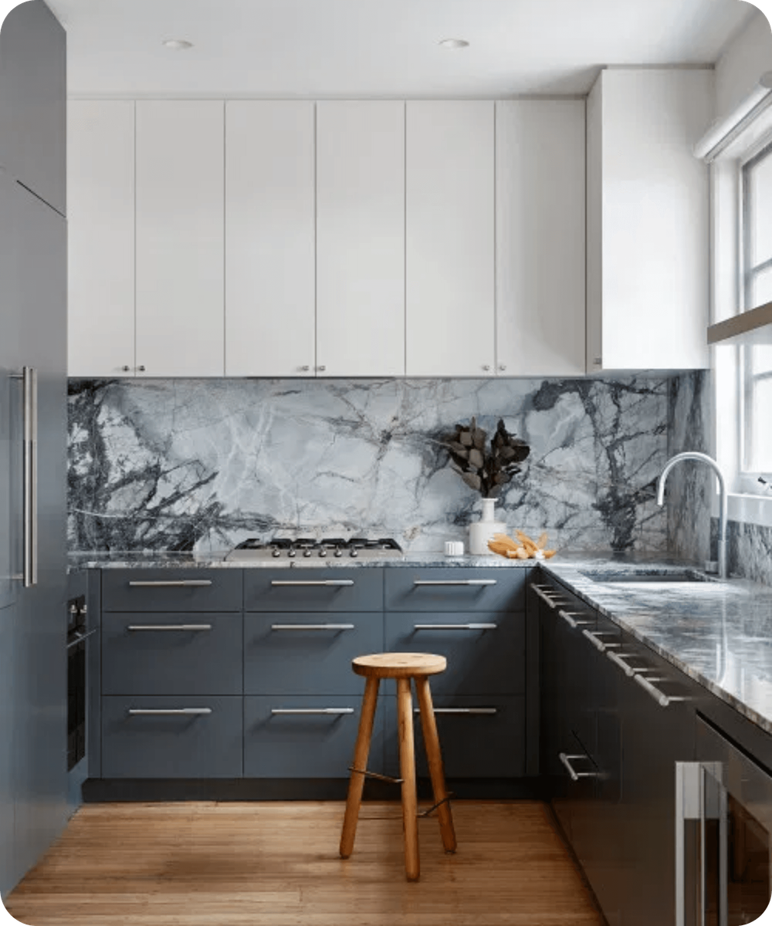




STRATEGIC RECOMMENDATIONS
WEBSITE ENHANCEMENTS
POLICY CLARITY
Add AR/EN language options, product reviews, and branch addresses with working hours.
Clearly define exchange, return, and warranty policies to build customer trust.
CONTENT STRATEGY
CUSTOMER ENGAGEMENT
Increase post frequency and create educational content on choosing the right cookware.
Organize Instagram Highlights and encourage post-purchase reviews for social proof.
LOYALTY REWARDS
Feature outstanding customers and offer exclusive rewards to build long-term brand loyalty and community.

Slide 11
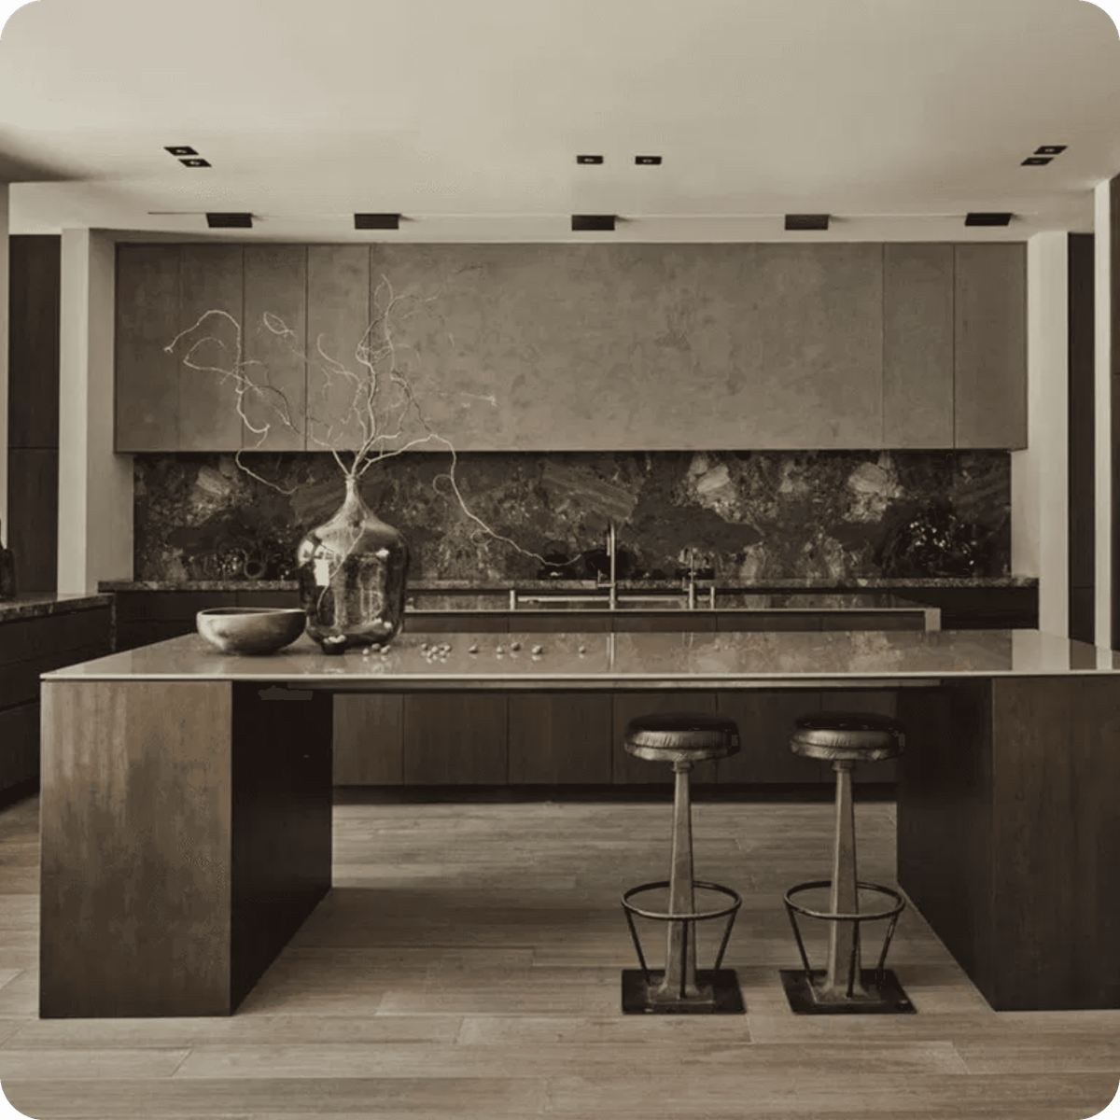

THANK YOU FOR YOUR ATTENTION

